Slide 1
Yr 10 Probability Review
EQ: What have we learned about probability so far?

Slide 2
5 Question warm up
1. What is the median and the range for the following data set? { 1, 2, 3, 5, 8, 8, 9}
2. Compare linear and quadratic relationships in words.
3. Factorise the following: a) 6g²+3g+18f b) 3r+m+e+gh+3r-d c) 16p+4
4. Find the turning point for the following quadratic equations: a) y = x² – x - 6 b) x² + 7x + 10
5. Solve for x when y = 0 a) (x-3)(x+3) b) x² - 6x + 8

Slide 3
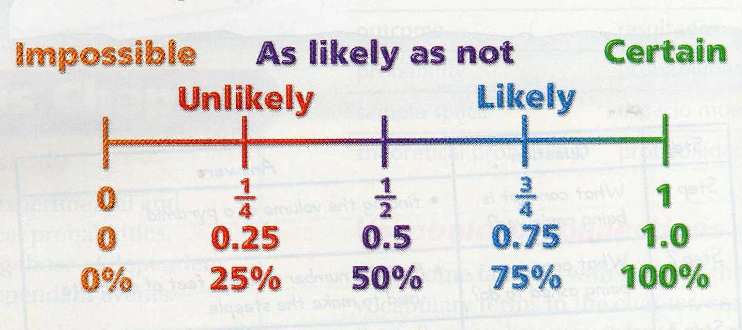
24
7
30
Topic: Probability
Date:
EQ – What have we learnt about probability so far?
Probability: is the likelihood that an event will occur.
Probability can be written as a fraction, decimal or a percent.
What is probability?
_______________
_______________
_______________

Slide 4
24
7
30
Topic: Probability
Date:
EQ – What have we learnt about probability so far?
Probability is always between 0 and 1.
Probability = 0 means that the event will NEVER happen.
Example: The probability that the Perth Wildcats will win the AFL Grand Final this year.
Probability = 1 means the event will ALWAYS happen.
Example: The probability that Christmas will be on December 25th next year.
What is probability?

Slide 5


Slide 6
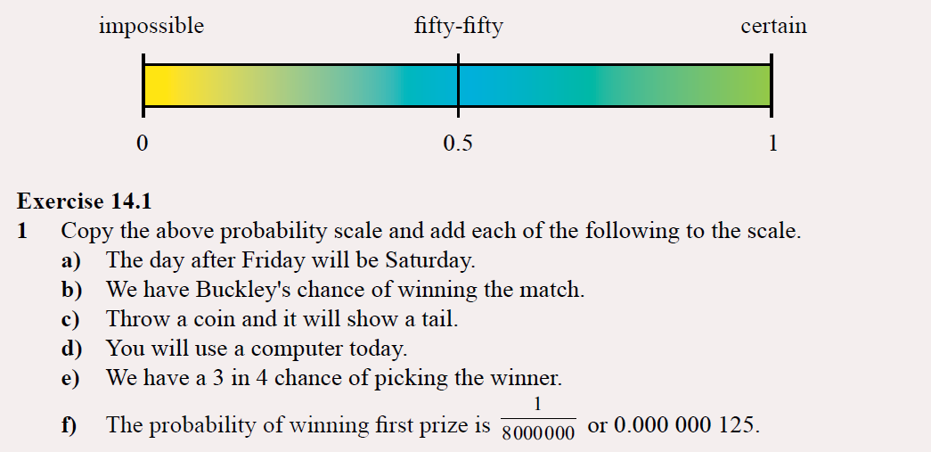
Practice - LHS
Notes:
Guide students through the question.
Option 2: Dot plots handout (Scaffolded for kids who may need extra help)

Slide 7
24
7
30
Topic: Probability
Date:
EQ – What have we learnt about probability so far?
What is the sample space?
The sample space is a list of all the possible outcomes. Sample spaces are identified by using the brackets
{ and }.
e.g. A normal six sided die has the numbers 1 to 6 on it. The sample space is: {1, 2, 3, 4, 5, 6}

Slide 8
Practise - LHS
Write the sample space for: a) Tossing 2 coins
b) Suits in a deck of cards

Slide 9
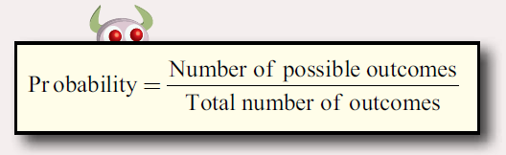
24
7
30
Topic: Probability
Date:
EQ – What have we learnt about probability so far?
How to calculate probability?

Slide 10
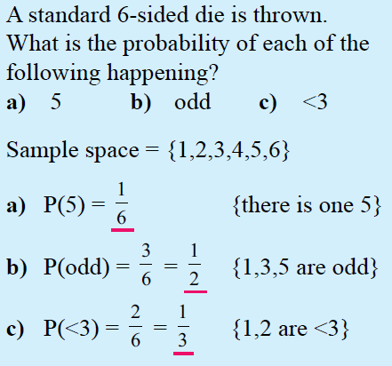
24
7
30
Topic: Probability
Date:
EQ – What have we learnt about probability so far?
Sample space: A list of all the possible outcomes.
{ } - These brackets are used when listing sample space
< 3 means less than 3, so 1OR 2
How to calculate probability?

Slide 11
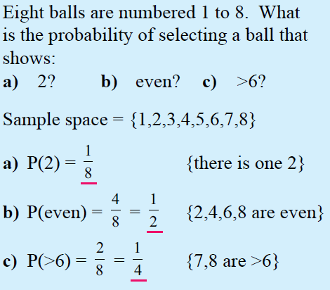
24
7
30
Topic: Probability
Date:
EQ – What have we learnt about probability so far?
> 6 means any number larger than 6, in our sample space.
How to calculate probability?

Slide 13
24
7
30
Topic: Probability
Date:
EQ – What have we learnt about probability so far?
Theoretical Probability: is the probability of what we expect to occur
e.g. The probability of rolling a 3 on a six sided dice is 1/6
Experimental Probability: is the probability that we get as the result of an experiment or simulation.
e.g. Experiment tossing a coin 20 times
P(Heads) = Number of possible outcomes = 11
Total number of outcomes 20
Compare theoretical and experimental probability
Heads | Tails
11 | 8

Slide 14
24
7
30
Topic: Probability
Date:
EQ – What have we learnt about probability so far?
Complement: means an event not happening.
E.g. The complement of it raining, is that it doesn’t rain.
What is complementary Probability?
The complement of event “A” is “not event A” - We write this as A’
Not A = A’
The sum of the probability of an event and its complete is 1
P(A) + P(A’) = 1.
Example, There is a 20% chance we will get ice-cream. There is then an 80% we wont. 20% + 80% = 100%, 100% = 1
Therefore P(A’) = 1 - P(A)

Slide 15
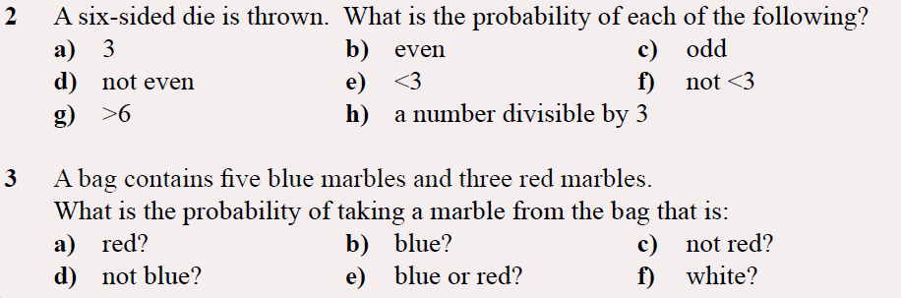
Task - LHS: Hint: List the sample space of all available outcomes first

Slide 16
Task - LHS:
Complete Ex 6.1 Q1-6 on Pg 235 of Nelson WA Maths 10
Notes:
Dwyer 10 doesn’t have jack for practise questions at this level.

